Slide 1
Pointers

Slide 2
Introduction to Pointers
Pointers are a fundamental concept in data structures and programming languages that allow efficient memory management and data manipulation. A pointer is a variable that stores the memory address of another variable, rather than its value. In other words, it "points" to the location in memory where the data is stored.

Slide 3
Memory Address: Every variable in a computer program is stored in a specific memory location, and each location has a unique address. Pointers are used to store and manipulate these memory addresses.
Declaration: Pointers are declared using an asterisk (*) before the variable name. For example, to declare a pointer to an integer, you would write int *ptr;, where ptr is the pointer variable.

Slide 4
Initializing Pointers: Pointers should be initialized before they are used. Initializing means assigning them the memory address of another variable. For example, int x = 10; int *ptr = &x; initializes ptr to point to the memory address of x.
Dereferencing: To access the value of the variable pointed by a pointer, you need to dereference it using the asterisk (*). For example, int value = *ptr; retrieves the value stored in the memory location pointed by ptr.

Slide 5
Example of Pointer Variable
int *p
Char *ch
int* p
Int * p
Int *p
All the above example means the same
Int *p, q(q is not a pointer variable here)
Int *p, *q

Slide 6
Example
Address of operator(&) Dereferencing operator(*)
Int x int x =25
Int *p int *p
p = &x p = &x
*p=55
(print at each step the values of x,&x,p,&p,*p)

Slide 7
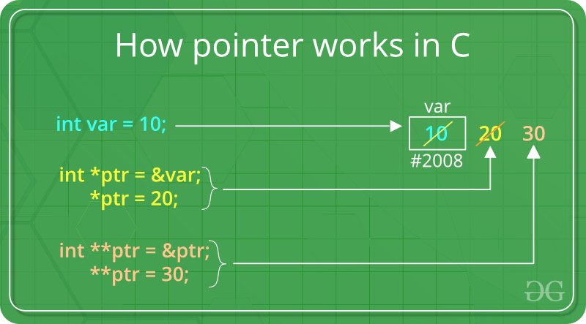
Accessing values using pointers

Slide 8
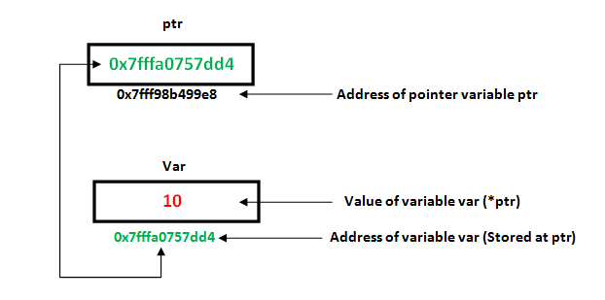
Accessing values with pointers
The reason we associate data type to a pointer is that it knows how many bytes the data is stored in.

Slide 9
APPICATIONS
Dynamic Memory Allocation: Pointers are essential for dynamically allocating memory during program execution. Functions like malloc() (in C/C++) or new (in C++) return a pointer to the newly allocated memory block.
Data Structures: Pointers enable the creation of dynamic data structures like linked lists. In a linked list, each element (node) contains a data field and a pointer to the next node. Pointers are used to traverse the list and connect nodes.

Slide 10
Dynamic Variables
Why pointers
Pointers manipulate data using existing memory spaces
Learned to use pointer to manipulate data into memory space created by other variables.(Same can be achieved using variables)
Variables created during program execution are called dynamic variables.
Two operators – new and delete
new datatype; (allocate single)
new datatype[positive integer] (allocate array, storing address of first variable)
Ex-
p = new int;
q = new char[16];
array in q,

Slide 11
Example
Int *p
Char *name
String *str
P=new int
*p=28
Name=new char[5]
Strcpy(name,”john”)
Str=new string
*str=“sunny day”

Slide 12
Dynamic variable deallocation
delete p;
delete [] name - array

Slide 13
In data structures, pointer arithmetic is commonly used in scenarios like:
Array traversal: Pointers allow you to iterate through arrays efficiently by incrementing the pointer to move to the next element.
Linked lists: Pointer arithmetic helps navigate between nodes in a linked list by moving the pointer from one node to the next.
Dynamic memory allocation: Pointers are used to manage dynamically allocated memory, such as arrays or matrices.

Slide 14
Binary trees: Pointer arithmetic allows traversal through binary tree nodes, moving to the left or right child nodes.
When using pointer arithmetic, it's crucial to be careful to avoid memory access violations and undefined behavior. A deep understanding of memory layout and data structure organization is essential to utilize pointer arithmetic effectively and safely.

Slide 15
Accessing values using pointers

Slide 16
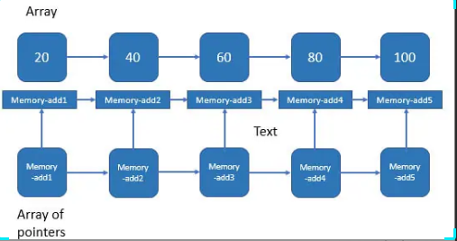
Array of pointers
Int array[5];
Int *array1[5];
array1=&array;

Slide 17
Pointers
Null pointer
Void pointer(generic pointer)

Slide 18
NULL Pointer
NULL Pointer is a pointer which is pointing to nothing. In case, if we don’t have address to be assigned to a pointer, then we can simply use NULL.

Slide 19
Null Pointers: Pointers can have a special value called NULL, which indicates that they do not currently point to any valid memory location. It's crucial to check for NULL pointers to avoid crashes and undefined behavior.
Pointers, while powerful, also require careful handling, as improper usage can lead to bugs like segmentation faults and memory leaks. Understanding pointers is essential for building efficient and flexible data structures in various programming languages.

Slide 20
#include <iostream>
using namespace std;
int main() {
int* ptr = NULL; // Creating a null pointer
cout<<ptr<<endl;
cout<<*ptr<<endl;
return 0;
}
Output
0
…(nothing is printed in screen when write *p)

Slide 21
This can be useful in various situations, such as
Initializing Pointers: When you declare a pointer but do not have a valid memory address to assign to it initially, you can set it to a null pointer. This helps in avoiding uninitialized pointer issues.
Error Handling: Null pointers can be used to signal and handle errors or exceptional conditions when memory allocation or resource acquisition fails.

Slide 22
#include <iostream>
using namespace std;
int main() {
int *Ptr1 = NULL; // Initialize a pointer to nullptr
//cout<<Ptr1<<endl;
if (Ptr1==0 ) {
cout << "Ptr1 is a null pointer." <<endl;
} else {
cout << "Ptr1 is not a null pointer." <<endl;
}
}
NOTE : if (Ptr1==NULL )

Slide 23
#include <iostream>
using namespace std;
int main() {
int *Ptr1 = NULL; // Initialize a pointer to nullptr
int *Ptr2 = NULL; // Initialize another pointer to nullptr
cout<<Ptr1<<endl;
cout<<Ptr2<<endl;
if (Ptr1==Ptr2 ) {
cout << "validPtr is a null pointer." <<endl;
} else {
cout << "validPtr is not a null pointer." <<endl;
}
if (Ptr1 == Ptr2) {
cout << "Ptr is a null pointer." <<endl;
} else {
cout << "Ptr is not a null pointer." <<endl;
}
return 0;
}

Slide 24
Void pointer
Void pointer is a specific pointer type – void * – a pointer that points to some data location in storage, which doesn’t have any specific type. Void refers to the type. Basically the type of data that it points to is can be any. If we assign address of char data type to void pointer it will become char Pointer, if int data type then int pointer and so on. Any pointer type is convertible to a void pointer hence it can point to any value.

Slide 25
#include <iostream>
using namespace std;
int main()
{
int x = 4;
float y = 5.5;
// A void pointer
void* ptr;
ptr = &x;
// (int*)ptr - does type casting of void
// *((int*)ptr) dereferences the type casted
// void pointer variable.
cout << "Integer variable is = " << *((int*)ptr)
<< endl;
ptr = &y;
cout << "Float variable is = " << *((float*)ptr) << endl;
return 0;
}

Slide 26
Constant
int *const is a declaration in C/C++ that defines a constant pointer to an integer. Let's break down what this means:
int *: This indicates that the variable is a pointer to an integer. The pointer itself can point to an integer variable.
const: Placed after the *, it means that the pointer itself is constant. This implies that once the pointer is initialized to point to a particular integer, it cannot be made to point to another integer. However, the value of the integer that the pointer points to can still be changed.
Example
int a = 10;
int b = 20;
int *const ptr = &a; // ptr is a constant pointer to an integer
*ptr = 15; // This is allowed. The value of 'a' is now 15.
// ptr = &b; // This would cause a compilation error, because 'ptr' is a constant pointer.
In this example, the pointer ptr can only point to a for its lifetime, but the value of a (which ptr points to) can be modified through the pointer.

Slide 27
Constant
const int *a
const int *a is a declaration in C/C++ that defines a pointer to a constant integer. Let's break down what this means:
int *a: This indicates that a is a pointer to an integer.
const: Placed before the int, it means that the integer value being pointed to by a is constant and cannot be changed through the pointer. However, the pointer itself (a) can be changed to point to another integer.
Example
int x = 10;
int y = 20;
const int *a = &x; // 'a' is a pointer to a constant integer
// *a = 15; // This would cause a compilation error, because the value at 'a' is constant.
a = &y; // This is allowed. The pointer 'a' can point to another integer.
In this example, the pointer a can be made to point to different integers (x or y), but the value of the integer that a points to cannot be changed through a.

Slide 28
Pointer Arithmetic
Pointer arithmetic in data structures refers to the manipulation of memory addresses using pointers to efficiently access and traverse data elements in memory. Pointers are variables that store the memory addresses of other variables or data structures. By performing arithmetic operations on pointers, you can move through the memory in a structured way.

Slide 29
Pointer arithmetic means manipulate the memory address by using pointers .So we access elements from memory in easy and efficient way. or u can say so we can perform operations on (data structure) in efficient way .

Slide 30
Operations on pointers
A limited set of arithmetic operations can be performed on pointers which are:
incremented ( ++ )
decremented ( — )
an integer may be added to a pointer ( + or += )
an integer may be subtracted from a pointer ( – or -= )
difference between two pointers (p1-p2)

Slide 31
Pointer Addition
Incrementing a Pointer: When you add an integer to a pointer, the pointer moves forward by that integer multiplied by the size of the data type it points to.
Syntax: ptr + n
Example:
int arr[5] = {1, 2, 3, 4, 5};
int *ptr = arr; // ptr points to arr[0]
ptr = ptr + 2; // ptr now points to arr[2]
Here, if ptr was pointing to an int, and int is 4 bytes, then ptr + 2 moves the pointer forward by 8 bytes.
Addition of Constant to Pointers
We can add integer values to Pointers and the pointer is adjusted based on the size of the data type it points to. For example, if an integer pointer stores the address 1000 and we add the value 5 to the pointer, it will store the new address as:
1000 + (5 * 4(size of an integer)) = 1020

Slide 32
Pointer Subtraction
Decrementing a Pointer: Subtracting an integer from a pointer moves the pointer backward by that integer multiplied by the size of the data type.
Syntax: ptr – n Example
int arr[5] = {1, 2, 3, 4, 5};
int *ptr = &arr[3]; // ptr points to arr[3]
ptr = ptr - 2; // ptr now points to arr[1]
We can also subtract a constant from Pointers and it is the same as the addition of a constant to a pointer. For example, if an integer pointer stores the address 1000 and we subtract the value 5 from the pointer, it will store the new address as:
1000 - (5 * 4(size of an integer)) = 980

Slide 33
Difference between Two Pointers
You can subtract one pointer from another if they point to elements of the same array. This gives the number of elements between them.
Syntax: ptr1 - ptr2
Example:
int arr[5] = {1, 2, 3, 4, 5};
int *ptr1 = &arr[3]; // ptr1 points to arr[3]
int *ptr2 = &arr[1]; // ptr2 points to arr[1]
int diff = ptr1 - ptr2; // diff is 2, the number of elements between arr[1] and arr[3]

Slide 34
Pointer Increment and Decrement
Increment (++): Moves the pointer to the next element.
Decrement (--): Moves the pointer to the previous element.
Incrementing or decrementing a pointer will make it refer to the address of the next or previous data in the memory. This process differs from incrementing and decrementing numeric data.
For example, when we increment or decrement a numeric data, its value is incremented or decremented by 1. However, incrementing or decrementing a pointer, instead of increasing or decreasing by 1, the address increases or decreases by 1 multiplied by the size of the data type it is pointing to. (one of the reasons why the pointer declaration requires the information about the type of data it is pointing to)

Slide 35
Pointer Increment and Decrement
Example:
int arr[5] = {1, 2, 3, 4, 5};
int *ptr = arr; // ptr points to arr[0]
ptr++; // ptr now points to arr[1]
ptr--; // ptr now points back to arr[0]

Slide 36
Example
using namespace std;
int main()
{
int num = 27;
// Storing address of num in num_pointer
int* num_pointer = &num;
// Print size of int
cout << "Size of int: " << sizeof(int) << endl;
// Print the address stored at num_pointer
cout << "Before Increment: " << num_pointer << endl;
// Increment pointer
num_pointer++;
cout << "After Increment: " << num_pointer << endl;
// Print the address stored at num_pointer
cout << "Before Decrement: " << num_pointer << endl;
// Decrement pointer
num_pointer--;
cout << "After Decrement: " << num_pointer << endl;
return 0;
}

Slide 37
Comparison of Pointers
In C++, we can perform a comparison between the two pointers using the relational operators(>, <, >=, <=, ==, !=). We generally use this operation to check whether the two-pointer as pointing to the same memory location or not.

Slide 38
Example
using namespace std;
int main()
{
// declaring some pointers
int num = 10;
int* ptr1 = &num;
int** ptr2 = &ptr1;
int* ptr3 = *ptr2;
// comparing equality
if (ptr1 == ptr3) {
cout << "Both point to same memory location";
}
else {
cout << "ptr1 points to: " << ptr1 << endl;
cout << "ptr3 points to: " << ptr3 << endl;
}
return 0;
}

Slide 39
Comparison to NULL
We can compare the pointer of a type to NULL. This operation helps us to find whether the given pointer points to some memory address or not. It helps us to control errors such as segmentation faults.
Example

Slide 40
Example
using namespace std;
int main()
{
int num = 10;
// assigning null in case we dont use pointer
int* ptr = NULL;
ptr = &num;
// checking if the pointer is in use or not
if (ptr == NULL) {
cout << "No value is pointed";
}
else {
cout << "The value pointed is " << *ptr;
}
return 0;
}

Slide 41
Quiz
What does a pointer store?
a) The value of a variable
b) The address of a variable
c) The data type of a variable
d) The size of a variable
Which operator is used to get the value at the address pointed by a pointer?
a) &
b) *
c) ->
d) .
Which operator is used to get the address of a variable?
a) &
b) *
c) []
d) ()

Slide 42
Advantages of Pointers are :-
Pointer provide direct access to the memory.
Pointer provide a way to returns more than one value to the functions.
Pointers provides an alternate way to access array elements.
Pointers reduces the storage space and complexity of the program.
Pointer reduces the execution of the program.

Slide 43
Quiz
If int *ptr = arr; where arr is an array, what does ptr + 1 point to?
a) arr[0]
b) arr[1]
c) arr[2]
d) arr[-1]
What is the output of the expression ptr1 - ptr2 where both pointers point to elements of the same array?
a) The difference in the memory addresses
b) The difference in the number of elements between them
c) The size of the data type
d) Undefined

Slide 44
Thanks

